Slide 1
EART 28202 : Structural Geology
Class 2 : How folds form
Notes:
In the notes panes to these slides there are numerous references (figure credits and further reading). If the reference is incomplete it refers to the references stated in the reading list on the last slide
With regard to figures in this PowerPoint file, many will be subject to copyright restrictions. I don’t care about you using any of the figures/photos that are mine (Steve Covey-Crump), although a credit would be nice, but take care to comply with copyright restrictions if you reuse any that are not

Slide 2
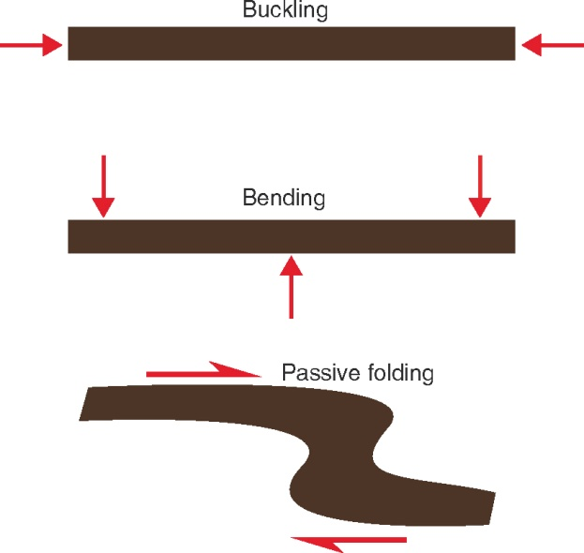
Types of folding
One of the key reasons for describing the geometry of folds (Class 1) is to place constraints upon how they formed
There are three basic types of folding:
Buckling: folding that occurs when layers are loaded parallel to the layering
Bending: folding that occurs when layers are loaded at a high angle to the layering
Passive folding: folding of marker bands that cross or are contained within a deforming unit
The focus today is primarily on buckling – there will be some brief remarks about folds formed by bending and about passive folding, but proper discussion of them will be deferred to the classes on tectonic regimes (Classes 8-10) and shear zones (Class 4)
Notes:
For a review of the sort of information that can be recovered from analysing fold geometry, see Hudleston & Treagus, 2010, Journal of Structural Geology 32: 2042-2071, https://doi.org/10.1016/j.jsg.2010.08.011. This is rather technical for 2nd year level, but it provides an insight into what research level structural geology can involve
Buckling is the flexing or folding of a surface by a compressive stress directed along that surface; the folds develop as the amplification (growth) of a mechanical instability (‘active folding’)
Bending of a surface arises when non-uniform forces are applied across that surface (the term ‘forced folding’ is sometimes used)
Passive folding is purely a kinematic effect – it describes the shape of a marker line that passes across a deforming material and is carried along in the flow
Figure from Fossen, p.265

Slide 3
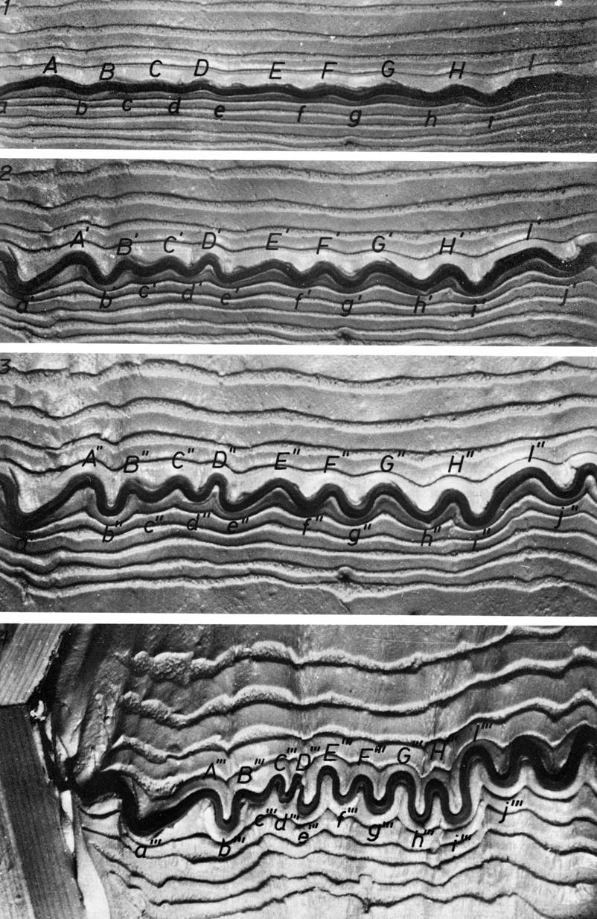
Buckling (introductory remarks)
Buckling = folding of a surface by a compressive stress directed along that surface → requires
the folded layer to be more competent (greater viscosity) than the interlayers (matrix)
small irregularities (mechanical instabilities) to be present on the layer interfaces – these serve as nucleation sites for the folds
The key variables that control the geometry of buckle folds have been identified from laboratory experiments on analogue materials and from numerical modelling
In laboratory and numerical work, the following are considered separately:
Buckling of single layers
Buckling of multilayers
Buckling of mechanically anisotropic units
Notes:
Viscosity is a measure of the resistance of a fluid to shear. Low viscosity materials are ‘runny’ whereas high viscosity materials are ‘stiff’ (compare the flow of water with that of syrup). On a geological timescale rocks flow and so can be considered as viscous fluids
Strictly defined, using terms that you will encounter later in the course unit, viscosity is the ratio of shear stress to shear strain-rate. Materials are said to be Newtonian viscous (or linear viscous) if their viscosity does not depend upon the shear force applied. The viscosity of rocks commonly decreases as the applied shear force is increased, that is, rocks are commonly ‘shear-thinning’, non-Newtonian fluids. Materials for which viscosity increases with shear force (‘shear-thickening’, non-Newtonian fluids) are not encountered in geological settings but there are non-geological materials that behave in this way – this is a reason why Einstein was interested in bread dough
The “small irregularities” are the mechanical instabilities around which the folds initiate. Without these there is nothing to kick the folding off
The theory of buckling is beyond the remit of this course – we shall confine ourselves to some of the features that the theory/laboratory experiments/numerical models attempt to explain. The development of buckling theory to describe folding in geological materials really began with the landmark studies of Biot and of Ramberg in the 1960s. For the papers describing these developments, see Hudleston & Treagus, 2010, Journal of Structural Geology 32: 2042-2071, https://doi.org/10.1016/j.jsg.2010.08.011. An excellent introductory overview is given by Price & Cosgrove (Chapters 11-13)
Figure (from Ramsay & Huber, 1987, p.388): four views of the progressive development of folds in a laboratory experiment (using plasticine) that was designed to investigate buckling of a single competent layer embedded in a homogeneous, less competent matrix

Slide 4
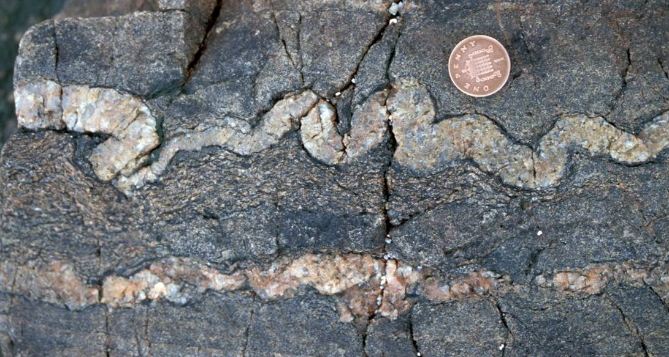
Single layer buckling
Classical buckling theory considers a single layer that has small sinusoidal perturbations of different wavelengths, and attempts to find the perturbation that amplifies faster than all the others
With some simplifying assumptions, the wavelength λ of the perturbation that amplifies fastest (and hence the dominant wavelength of the fold) is found to be given by
λ = 2π d [ η _{L} / ( 6η _{M} ) ]^{1/3}
where d is the layer thickness, and η _{L} and η _{M} are the viscosities of the layer and matrix
It is found that the effect of the folding disappears rapidly away from the folded layer (it is negligible at distances of about one wavelength away)
The folded layer approximates a Class 1B fold (parallel fold)
Notes:
The simplifying assumptions include (a) that the layer and matrix are Newtonian viscous, (b) that the weight of the layer has no effect, and (c) that there is no shortening parallel to the layer that is not accommodated by the buckling (that is, the layer does not get thicker as it is shortened). The analysis is also a two-dimensional one in the profile plane (no movement of material into or out of that plane). More sophisticated models allow these assumptions to be relaxed
A Class 1B fold is a parallel fold – the orthogonal thickness of the layer remains constant around the fold (see Class 1 Slides 20-21)
Photo (Steve Covey-Crump): a folded layer within Moine metasedimentary units, Ross of Mull, Scotland. Note that the folds in the layer just beneath the penny are not present in the vein at the bottom of the photo, thereby highlighting how rapidly the effect of folding disappears away from the folded layer

Slide 5
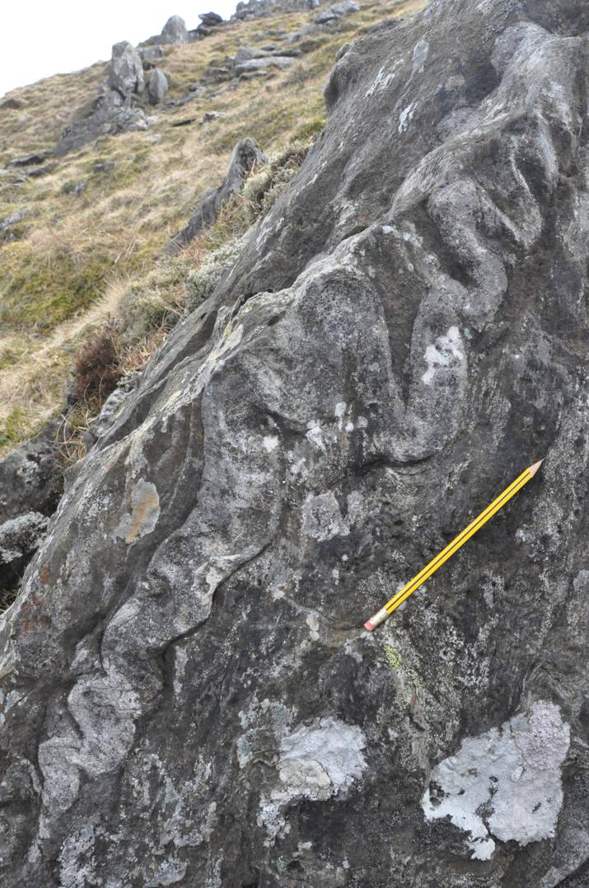
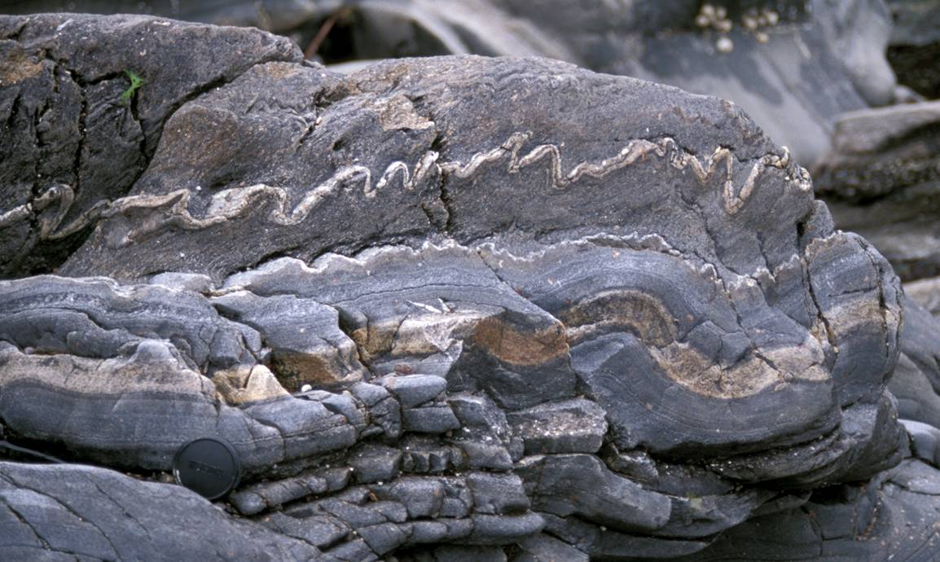
Single layer buckling (wavelength/thickness)
λ = 2π d [ η _{L} / ( 6η _{M} ) ]^{1/3}
From this relation it follows that fold wavelength (λ) increases as layer thickness (d) increases
Notes:
Photo left (Steve Covey-Crump): folded layers in the Ardalanish Striped and Banded Formation (part of the Moine metasedimentary sequence), Ross of Mull, Scotland. Note that the thinner layers have shorter wavelengths than the thicker layer at the bottom
Photo right (Steve Covey-Crump): a folded layer from the Kinlochleven field mapping area. Note the change in fold wavelength as the thickness of the layer changes

Slide 6
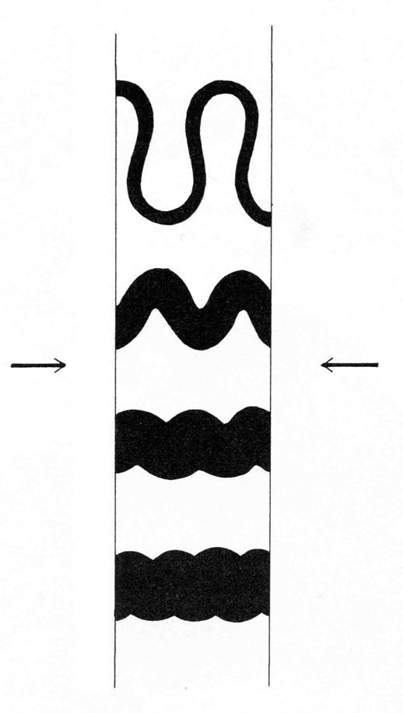
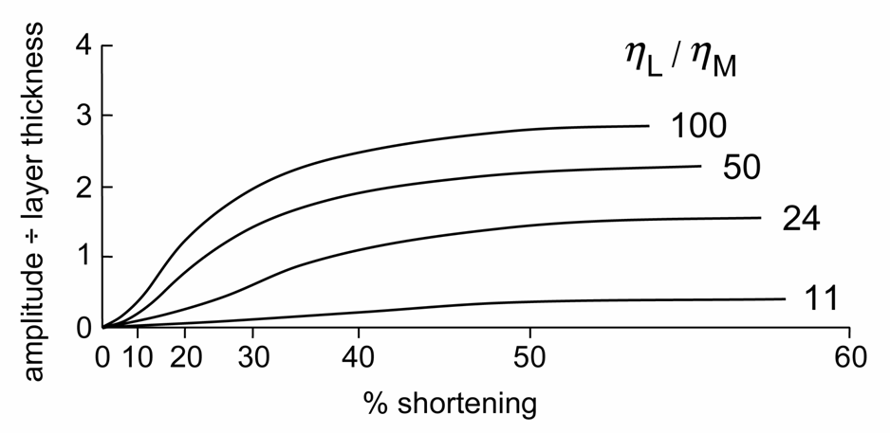
Single layer buckling (viscosity contrast)
λ = 2π d [ η _{L} / ( 6η _{M} ) ]^{1/3}
One of the most useful interpretations provided by equations of this kind is the possibility of recovering the viscosity contrast between layer and matrix ( η _{L} / η _{M} ) from measurements of λ and d in real folds
It can also be shown that large viscosity contrasts lead to more rapid fold amplification and less layer thickening (that is, layer
increasing viscosity contrast
parallel shortening other than buckling)
Effect of viscosity contrast on the rate of fold amplification
η _{L} /η _{M}
Buckling of four layers with the same initial thickness but with different layer / matrix viscosity contrasts
Notes:
Viscosity contrast is significant because (if we know what the layers are made of) it allows us to say something about the conditions of the deformation (e.g., temperature, how fast the deformation occurred). Further research is needed to develop the theoretical analysis sufficiently to allow reliable quantitative estimates of viscosity contrast from fold wavelength. However, valuable qualitative insights are possible – for an illustrative example see Ramsay & Huber, Question 19.3 (p.386-387 and p.397-401). An example of a study in which the wavelength vs. thickness relationships of naturally folded quartz veins in slates and phyllites were used to extract information about vein-matrix viscosity contrast is Sherwin & Chapple, 1968, American Journal of Science 266: 167-179, https://doi.org/10.2475/ajs.266.3.167
The shape of asymmetric pinch-and-swell structures (for what these are, see Class 1 Slides 41-43) may also be used to say something about the viscosity contrast between a layer that exhibits pinch-and-swell and the units on either side of it (e.g., Gardner et al., 2016, Journal of Structural Geology 88: 32-45, https://doi.org/10.1016/j.jsg.2016.04.012)
Figure bottom left (redrawn by Steve Covey-Crump from Ramsay & Huber, p.394): fold amplitude ÷ competent layer thickness as a function of % shortening in the laboratory single layer buckling experiments of Hudleston, 1973, Tectonophysics 16: 189-214, https://doi.org/10.1016/0040-1951(73)90012-7. Note that at given % shortening, the amplitude increases with increasing viscosity contrast between layer and matrix
Figure right (from Ramsay & Huber, p.394): note how layer thickening decreases and fold amplitude increases with increasing viscosity contrast between layer and matrix

Slide 7
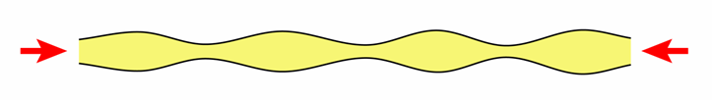
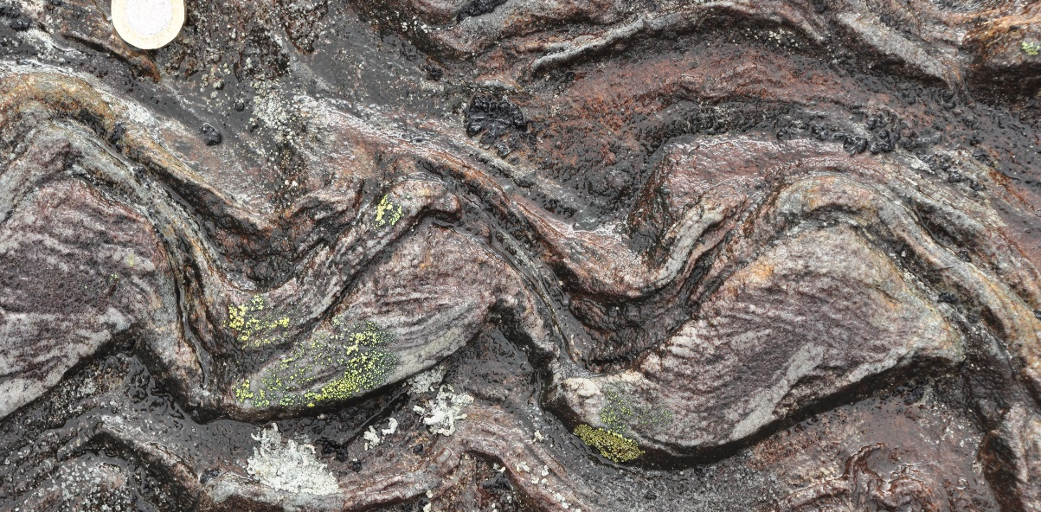
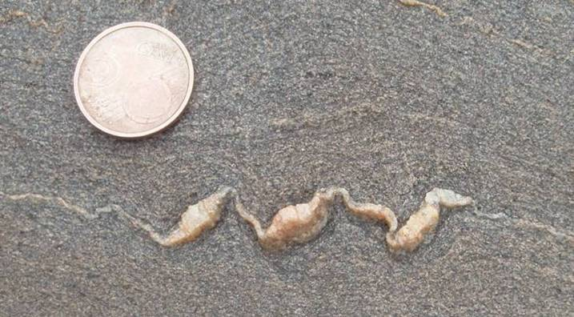
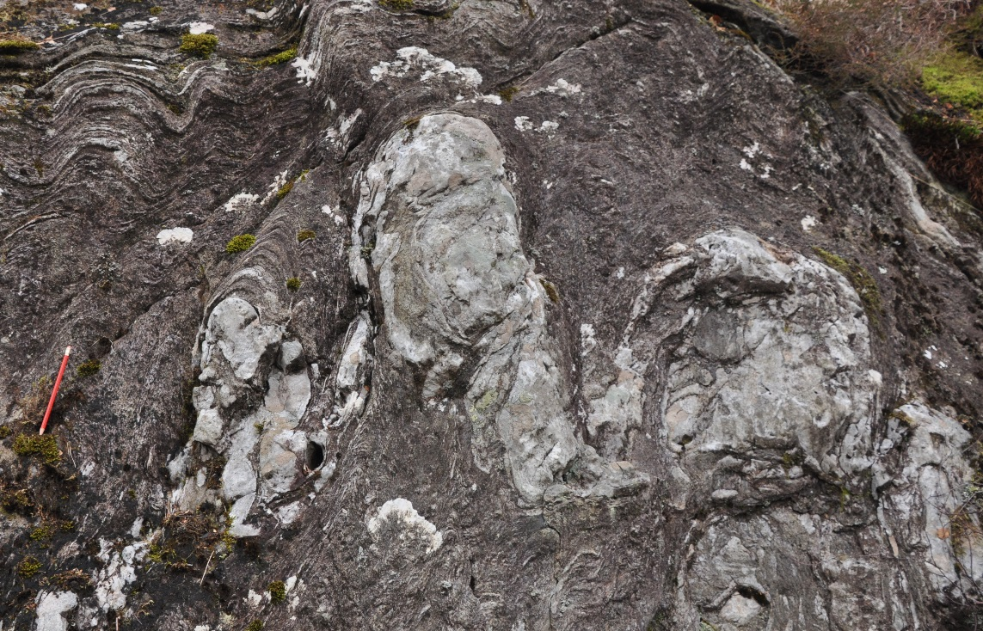
The exception – folded pinch-and-swell
If the layer thickens and thins as in pinch-and-swell then deformation is concentrated in the thin parts and it is the spacing of these that controls the fold wavelength, not the layer thickness
The fold wavelength of a boudinaged layer is not, however, controlled by the width of the boudins
Notes:
Folds of this kind form when layers that have previously been extended are buckled. In that situation, recognition of this geometry allows one to appeal to two phases of deformation: (1) a phase of layer-parallel extension followed by (2) folding. As we shall see in the next class, these two phases may not be completely separate events but can be early and late stages of a single progressive deformation event
The effect of pinch-and-swell on folds has been investigated experimentally. The folds form such that the thicker parts of the layer (the ‘swells’) always rotate in the same direction so that they stack up in a fashion that looks superficially like imbrication. For further discussion, see Price & Cosgrove, p.426-428
Photo top left (www.verityinsweden.blogspot.co.uk/2007/03/smallest-boudinage-sounds-like-kids.html): Cap de Creus, northern Spain
Photo top right (Steve Covey-Crump): a folded quartzite bed, Kinlochleven, Scotland. The quartzite is cross-bedded (younging upwards on the photo) but the point of interest for this class is the shape of the folded layer – note how one limb is much thicker than the other. This is evidence that the layer has been extended before the folding, that is, it provides evidence for at least two different phases of deformation
Photo bottom left (Steve Covey-Crump): another folded quartzite bed, Kinlochleven, Scotland, showing a set of folds - in each fold one limb is much thicker than the other. Hence, again this is evidence of layer-parallel extension before the folding

Slide 8
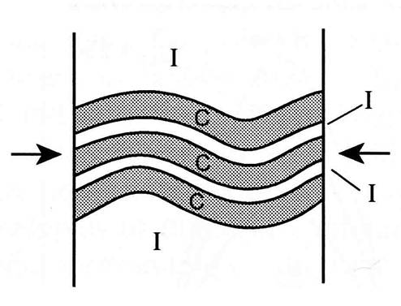
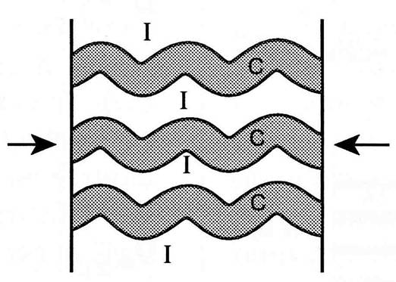
Multilayer buckling 1
Most natural folding involves multilayers (e.g., sedimentary sequences) and so the influence that individual layers exert on each other during folding needs to be considered
If the competent (high viscosity) layers are close together then they behave collectively as a thick single layer. This produces long wavelength folds [effective single layer]
If the competent layers are a little further apart and the layer thickness and spacing are not too variable, then the equation for single layer buckling is modified to
λ = 2π d [ Nη _{L} / ( 6η _{M} ) ]^{1/3}
where N is the number of competent layers in the package [harmonic folding]
Effective single layer (left)
Harmonic folding
(right)
Notes:
Figures from Hudleston & Treagus, 2010, Journal of Structural Geology 32: 2042-2071, https://doi.org/10.1016/j.jsg.2010.08.011

Slide 9
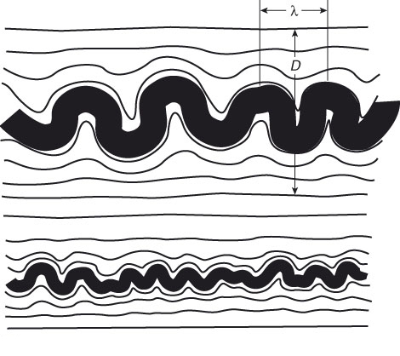
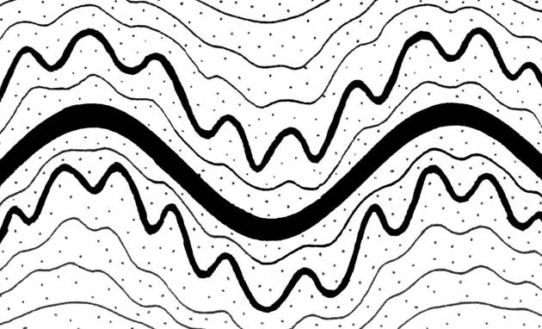
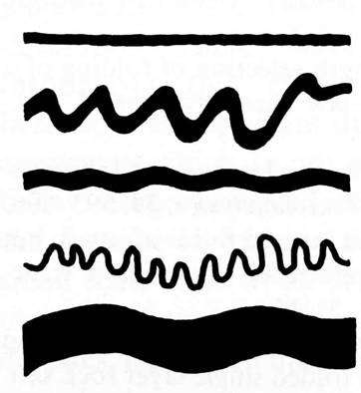
Multilayer buckling 2
A variant of the harmonic folding case occurs when the competent layers vary markedly in thickness and/or in viscosity contrast with the matrix. In this case, folds with more than one wavelength develop but the package conforms to the folding geometry of some controlling layer [polyharmonic folding]
If the competent layers are further apart than each other’s zone of influence (about one wavelength), then each layer folds independently [disharmonic folding]
Polyharmonic folding
D is the zone of influence either side of a competent layer
Disharmonic folding
Notes:
Figure left from Ramsay & Huber, p.406
Figure middle from Twiss & Moores, p.290. We noted the zone of influence on Slide 4
Figure right from Ramsay, 1967, Folding and Fracturing of Rocks, p.380, but deriving ultimately from Ramberg, 1964, Tectonophysics 1: 307-341, https://doi.org/10.1016/0040-1951(64)90020-4

Slide 10
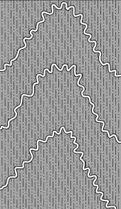
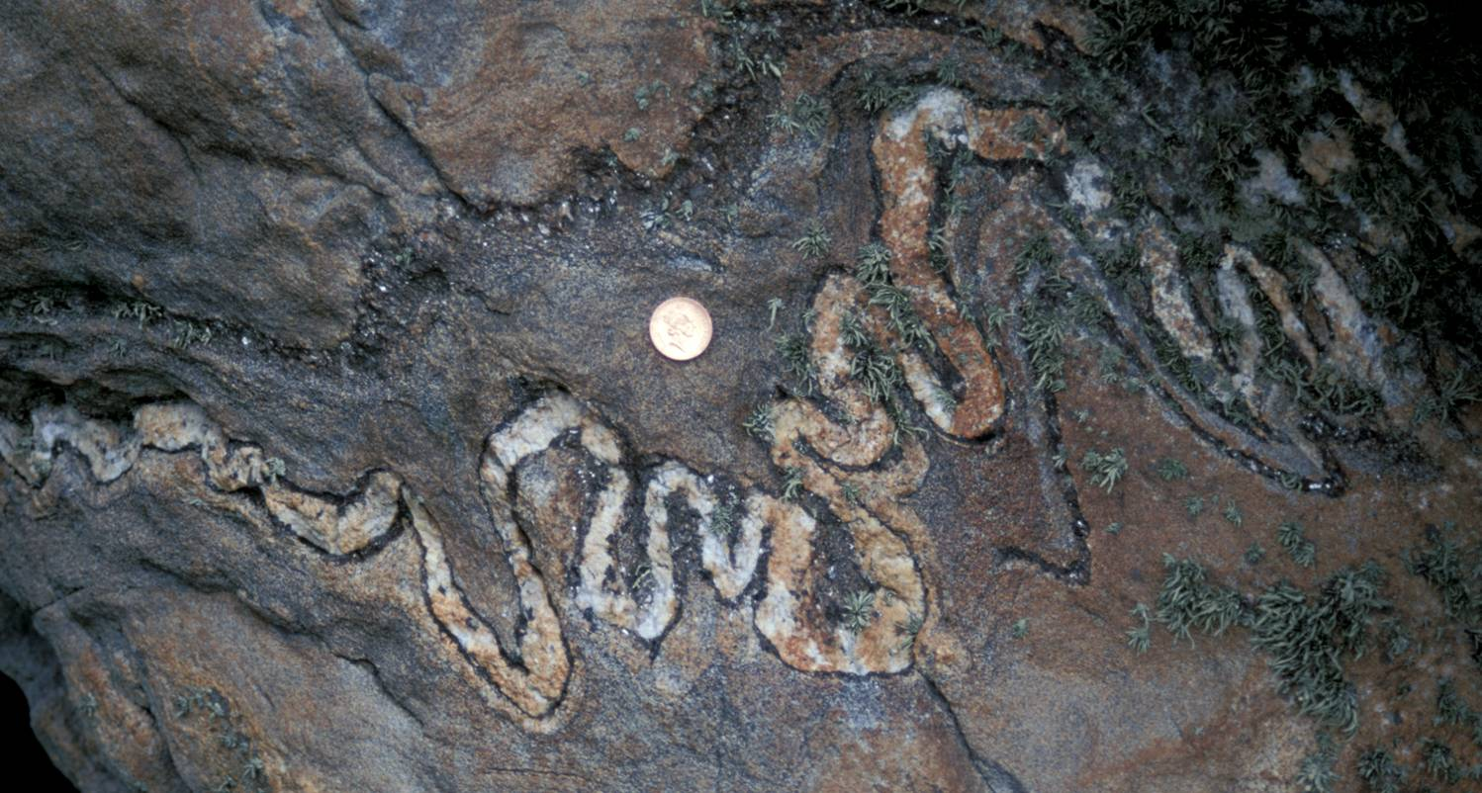
Multilayer buckling 3
If the relatively incompetent layers are much thicker than the competent layers, then the incompetent layers control the large-scale deformation. The thin competent layers take on a form in which the fold wavelength/layer thickness relationships are quite regular, but the orientation of the fold axial surfaces varies greatly. This form of disharmonic folding is described as ptygmatic folding
Notes:
In ptygmatic folds the limbs commonly curve back on themselves
Figure left from Twiss & Moores, p.379
Photo (Steve Covey-Crump): ptygmatically folded vein in the Ardalanish Striped and Banded Formation (part of the Moine metasedimentary sequence), Ross of Mull, Scotland

Slide 11
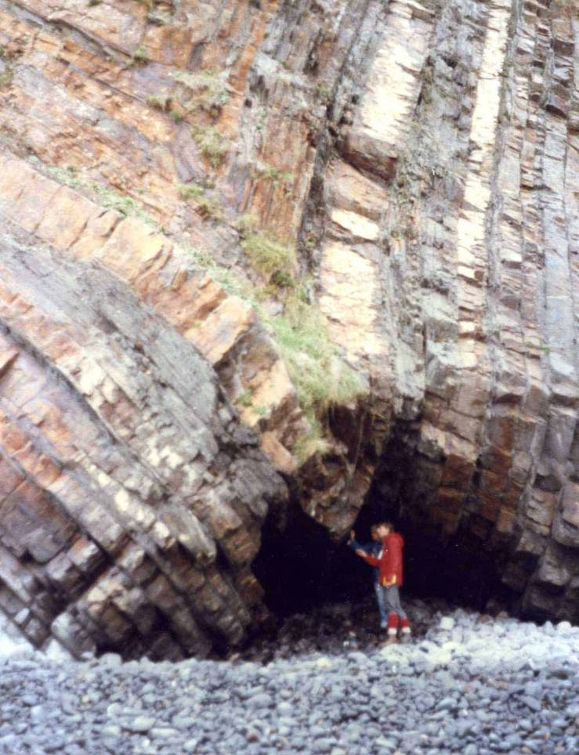
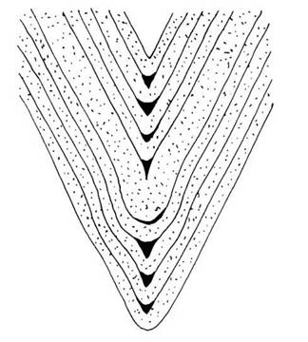
Multilayer buckling (accommodation structures 1)
The resistance to buckling is proportional to layer thickness cubed and so anomalously thick layers control the buckling response of the whole multilayer → the fold wavelength of the multilayer is given by that of the thick layer, and all other layers adjust to its shape
This, and the ptygmatic folding case, are examples of a more general situation in which layers with thickness and/or viscosity characteristics that mean that they start to fold early and come to have limbs that are too long or short for the ultimate fold shape, are forced to adjust when the controlling layer starts to buckle
The structures that form to allow this adjustment are described as accommodation structures
Keel-like hinge (hinge-collapse)
Notes:
The photo on this slide shows a relatively thick layer that started to fold early but then subsequently had to adjust its shape to conform to the fold shape of the whole multilayer. It did so by forming a keel-like hinge. Note that on the slide I say that the shape of thin layers generally needs to adjust to accommodate the shape of some thick, controlling layer. The case shown in the photo is the reverse situation (shape of a thick layer was controlled by the shape of a package of thin layers) - this arises when chevron folds form (chevron folds are folds with ‘sharp’ hinges, see Class 1 Slide 18) because in chevron folds the dip of the limbs for a given amount of shortening depends upon layer thickness (see Price & Cosgrove, p.319ff, or Ramsay and Huber, vol.2, p.422ff)
Photo (Steve Covey-Crump): Warren Beach, north side of Hartland Quay, north Devon. For a straightforward guide to the geology of this classic folding locality, see Cornford & Childs, 1989, Geology at Hartland Quay
Figure from Price & Cosgrove, p.320

Slide 12
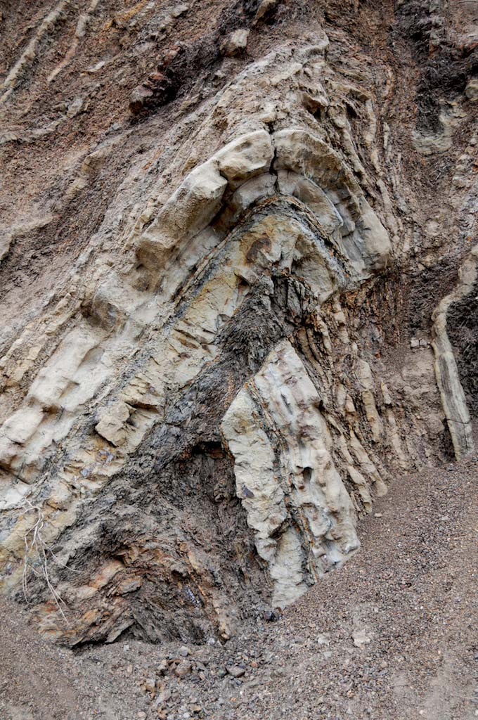
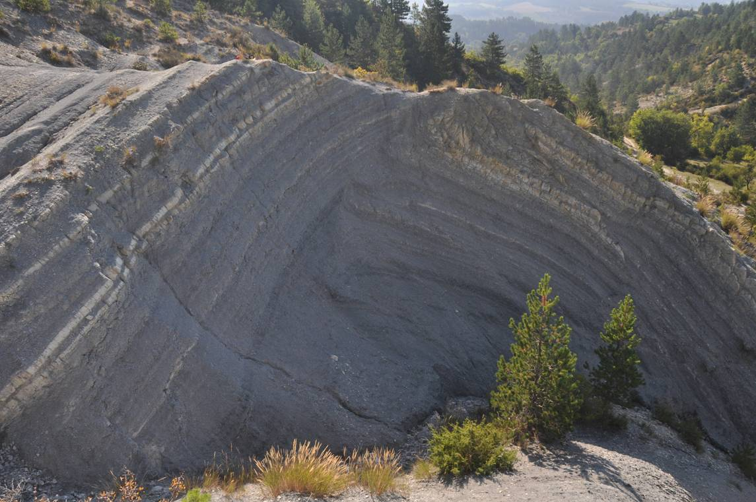
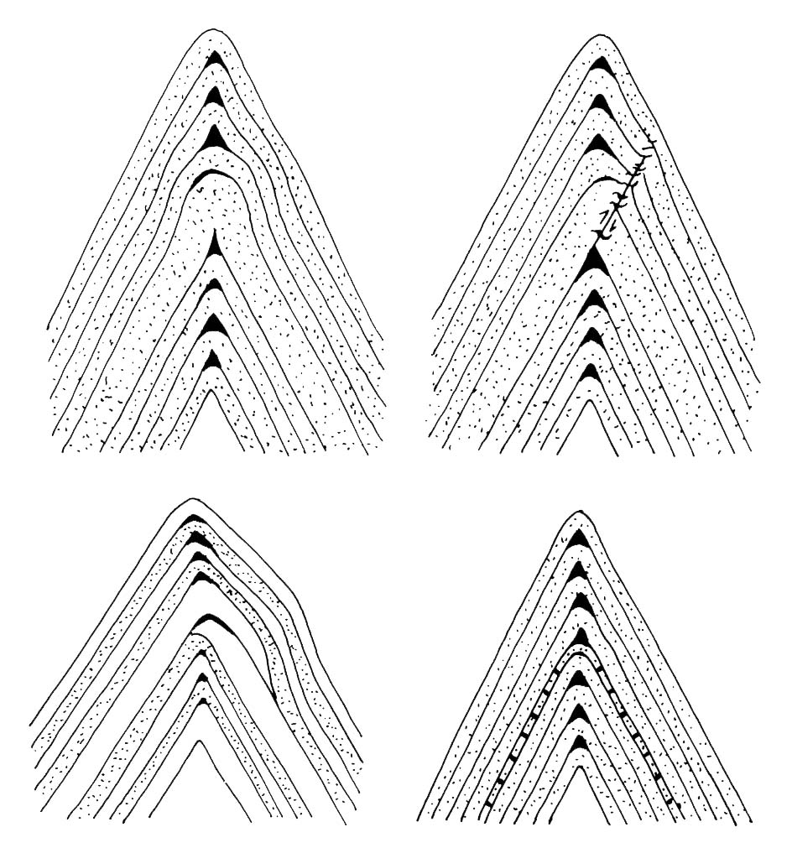

Multilayer buckling (accommodation structures 2)
Hinge thrust over
Reverse faulting in the hinge
Boudinaged limb
Notes:
Photo left (Fossen, one of the extra figures on the web-site for his book, folk.uib.no/nglhe/StructuralGeoBook.html): Palmdale, California (deformation associated with the San Andreas Fault)
Photo right (Steve Covey-Crump): Les Sauzeries Formation mudstones in the Barrême Basin (at St. Jacques), France. Note that there is an additional thrust in the far limb which repeats the light-coloured layer
The three small figures are from Price & Cosgrove, p.320

Slide 13
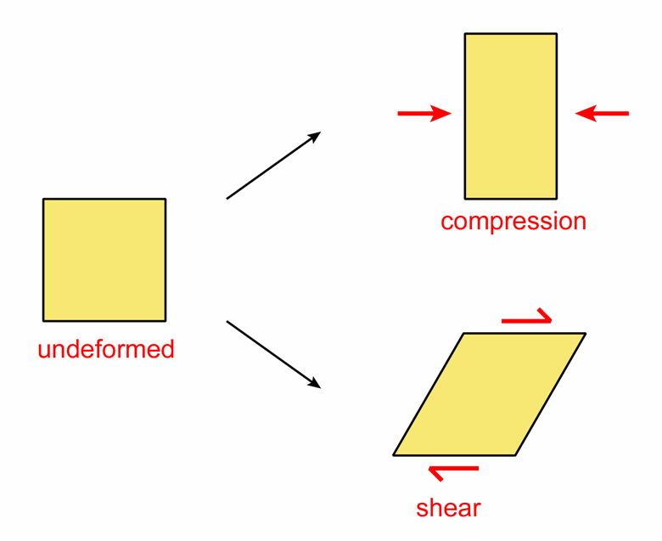
Buckling anisotropic rocks 1
Modelling the buckling behaviour of multilayers may be carried out by treating the individual layers as separate entities and by then predicting how the layers interact when the multilayer is compressed along the layering (the perspective of the last few slides)
Alternatively, one can model buckling by treating the multilayer as a statistically homogeneous but mechanically anisotropic material
In this case, by anisotropic we mean that the resistance to shearing is different to the resistance to compression
Materials that are classically anisotropic in this way are thinly-bedded multilayers or rocks with a strongly developed penetrative fabric such as a cleavage (e.g., slates)
The modelling proceeds by finding the condition for the appearance of an instability that interrupts uniform shortening and leads to the layering becoming non-planar
Notes:
A helpful introduction to the buckling of anisotropic rocks is given by Price & Cosgrove, Chapter 13
We will consider more rigorous definitions of terms like compression and shear in Class 3
Mathematically, an instability arises when the solution to an equation is very sensitive to the values of the input parameters, e.g., if the solution to an equation using the value x + Δx where Δx is very small, is very different to the solution using the value x
Figure by Steve Covey-Crump

Slide 14
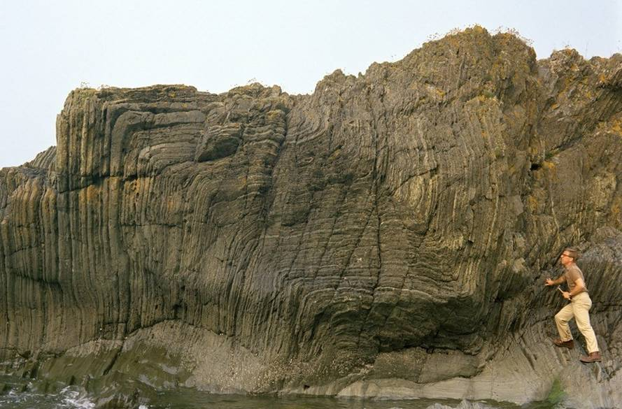
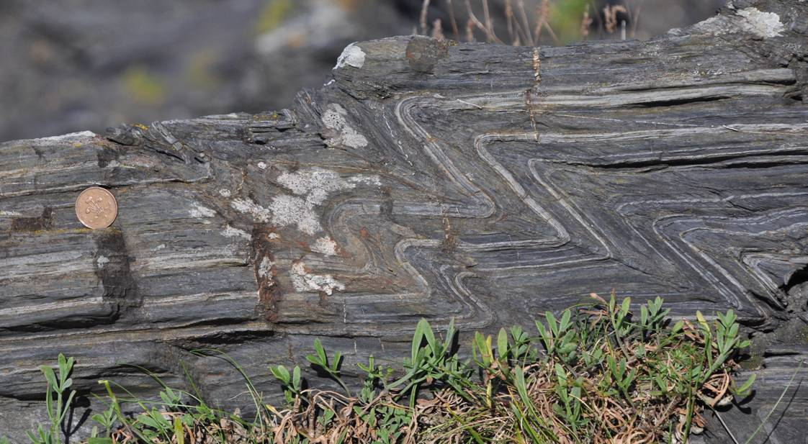
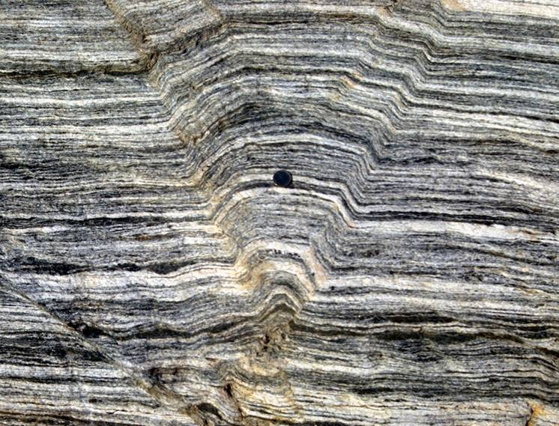
Buckling anisotropic rocks 2
Geometric features that can be explained by analysing multilayers as anisotropic materials, but which cannot be described using other approaches include:
Folds with very straight limbs
Folds with axial planes that are oblique to the original layering even when the principal compression is along the layering
Kink bands
Notes:
Photo top right (BGS image database: geoscenic.bgs.ac.uk/asset-bank/action/viewHome, image P005823): chevron folds in Late Ordovician thinly interbedded sandstones and mudstones, Ardwell, south of Girvan, Scotland. The short middle limb can be described as a kink band (here, a dextral contractional kink band – see next slide)
Photo bottom left (Steve Covey-Crump): kink-like folds in Carboniferous units, Penally Point, north side of Boscastle Harbour, north Cornwall. For an account of the folding at this locality, see Dearman & Freshney, 1966, Proceedings of the Geologists' Association 77: 199-213, https://doi.org/10.1016/S0016-7878(66)80070-6
Photo bottom right (Fossen, p.273): conjugate contractional kink bands defining a box fold, from Bergen, Norway

Slide 15
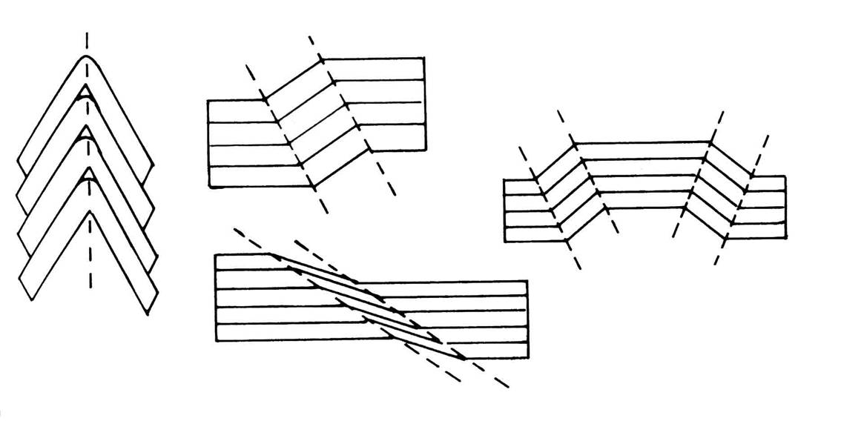
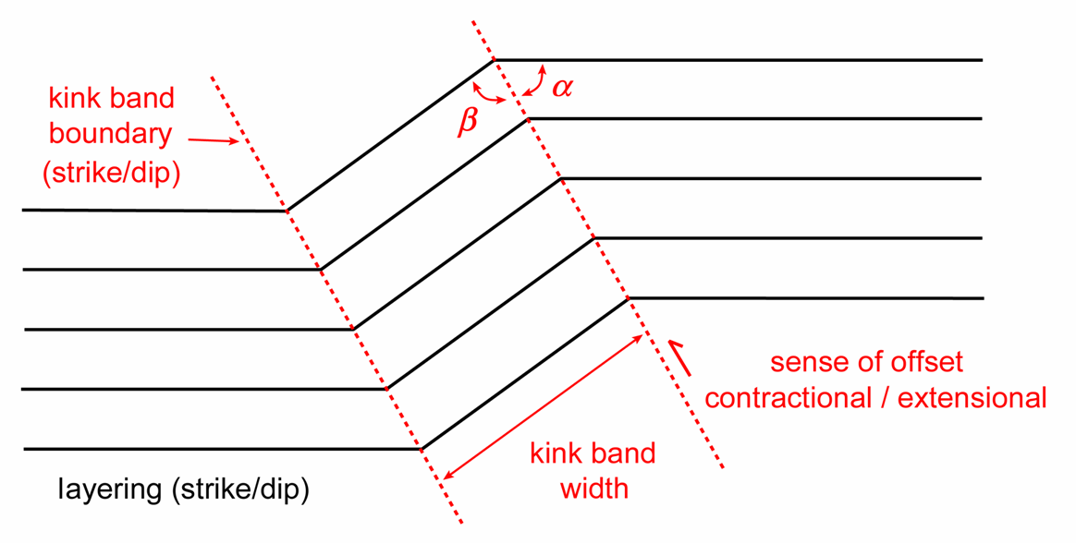
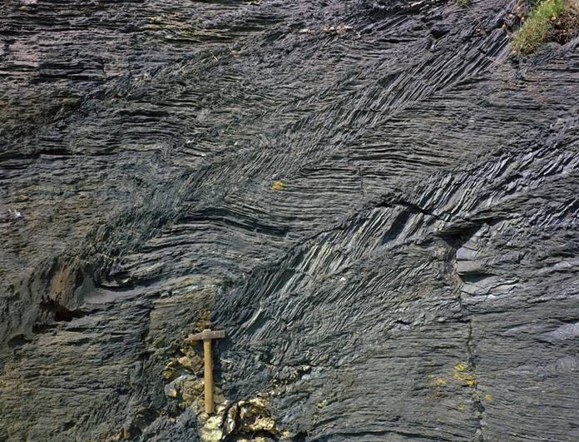
Buckling anisotropic rocks (kink bands)
Kink bands and folds with kink-like geometries have a Class 2 fold (similar fold) geometry but the angularity of their hinges means that dip isogon methods cannot be used to describe them
Instead, the angles and dimensions indicated on these diagrams need to be stipulated
Contractional kink band
(sinistral)
Conjugate kink bands
Chevron
Extensional kink band
(dextral)
Contractional dextral
Notes:
A Class 2 fold is a similar fold – the layer thickness parallel to the axial plane is constant around the fold (see Class 1 Slide 20)
Although kink bands are geometrically simple features, their mechanism of formation presents a number of challenges (see Weiss, 1980, Tectonophysics 65: 1-38, https://doi.org/10.1016/0040-1951(80)90221-8)
Photo (BGS image database: geoscenic.bgs.ac.uk/asset-bank/action/viewHome, image P210253): two dextral contractional kink bands in Carboniferous slates, foot of the quayside on the south side of Boscastle Harbour, north Cornwall
Figure top right compiled by Steve Covey-Crump from Price & Cosgrove, p.247
Figure bottom right by Steve Covey-Crump. Using these orientations and angles, one can say something about the amount of shortening and volume change during the deformation (see Ramsay & Huber, p.427-433) and something about the orientation of the stresses responsible for them (see Ramsay & Huber, Question 20.4, p.410-411 and p.434-435)

Slide 16
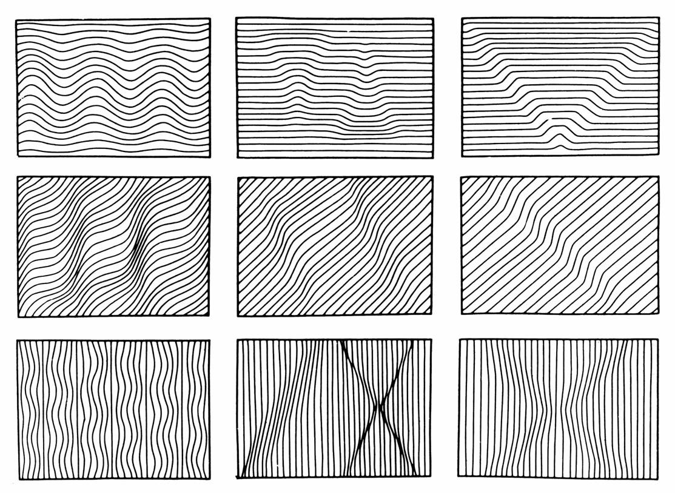
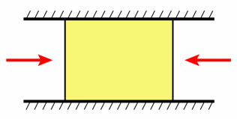
Buckling anisotropic rocks 3
Modelling shows that the geometry of the structures obtained depends upon the degree of anisotropy and the angle at which the multilayer is compressed relative to the layering
loading parallel to layering
loading normal to layering
increasing anisotropy
Such models show that boudinage and extensional kink bands can be formed by layer-normal compression – they are not produced only by active layer-parallel extension
Notes:
We defined buckling as the flexing or folding of a surface by a compressive stress directed along that surface (Slide 2). In the bottom three panes we refer to buckling arising when a load is applied normal to the layering. This is not a contradiction – in the figure we are assuming that each illustrated rectangle cannot expand in the vertical direction (as shown in the small diagram top right). If we compress the layers normal to the layering, then they attempt to extend parallel to the layering but if we do not allow this, a compressive stress is directed along the layers
Figure top right by Steve Covey-Crump
Main figure from Cosgrove, 1976, Journal of the Geological Society, London 132: 155-178, https://doi.org/10.1144/gsjgs.132.2.0155

Slide 17
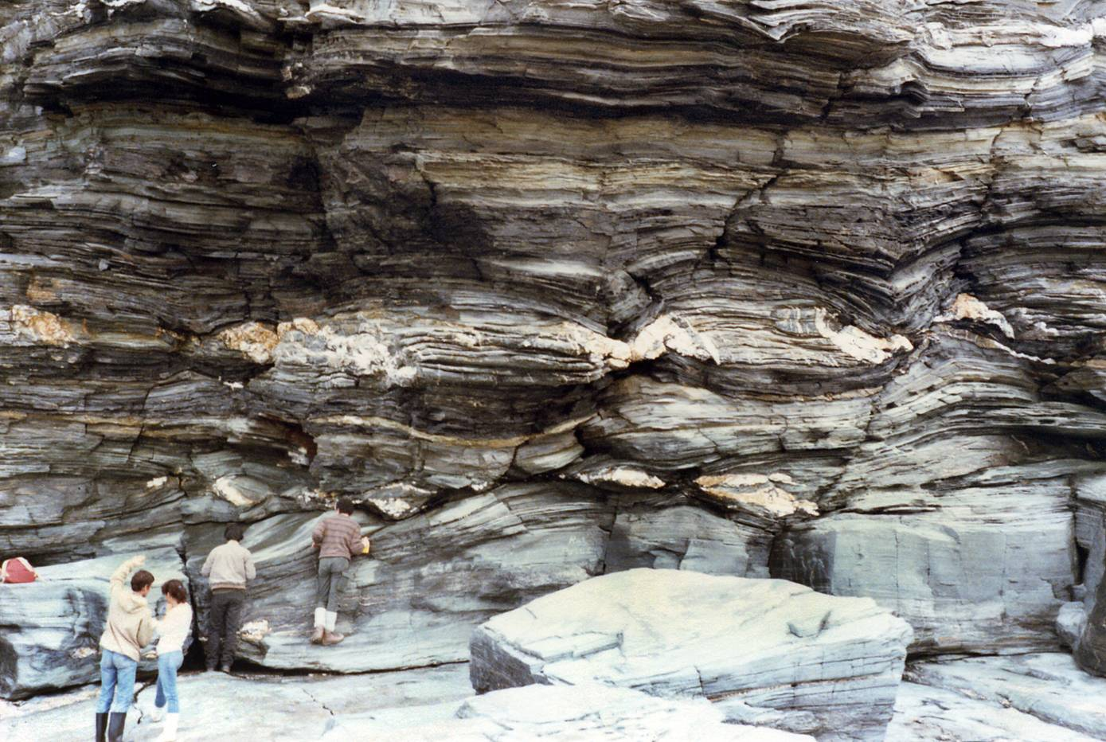
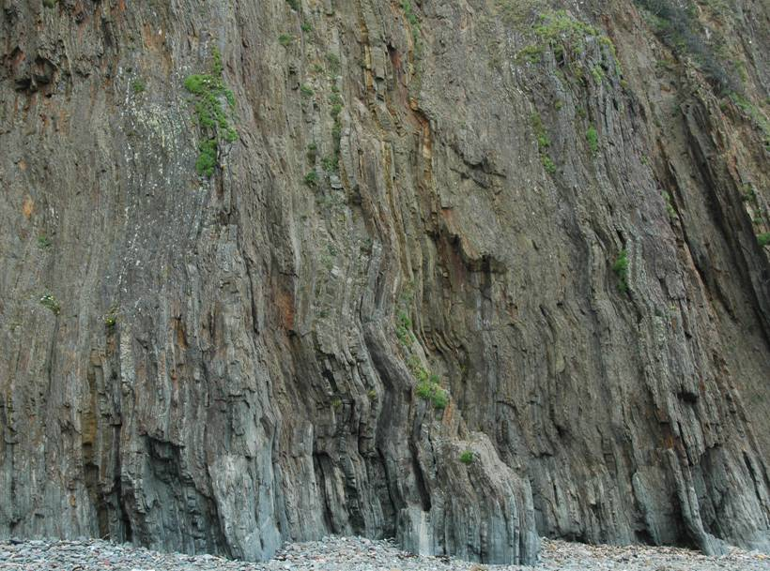
Buckling anisotropic rocks 4
Boudinage caused by layer normal compression
Wavy folds caused by layer parallel compression
Notes:
Photo top (Steve Covey-Crump); boudinage produced by compression in the vertical direction on this photo, from Tintagel, Cornwall
Photo bottom (Steve Covey-Crump): wavy folds produced by compression in the vertical direction on this photo, from Marloes Sands, Pembrokeshire

Slide 18
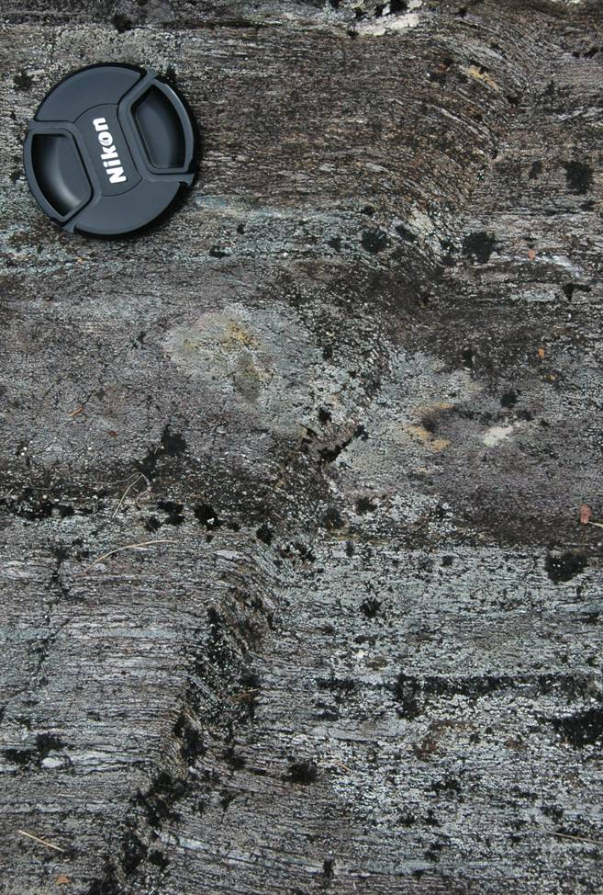
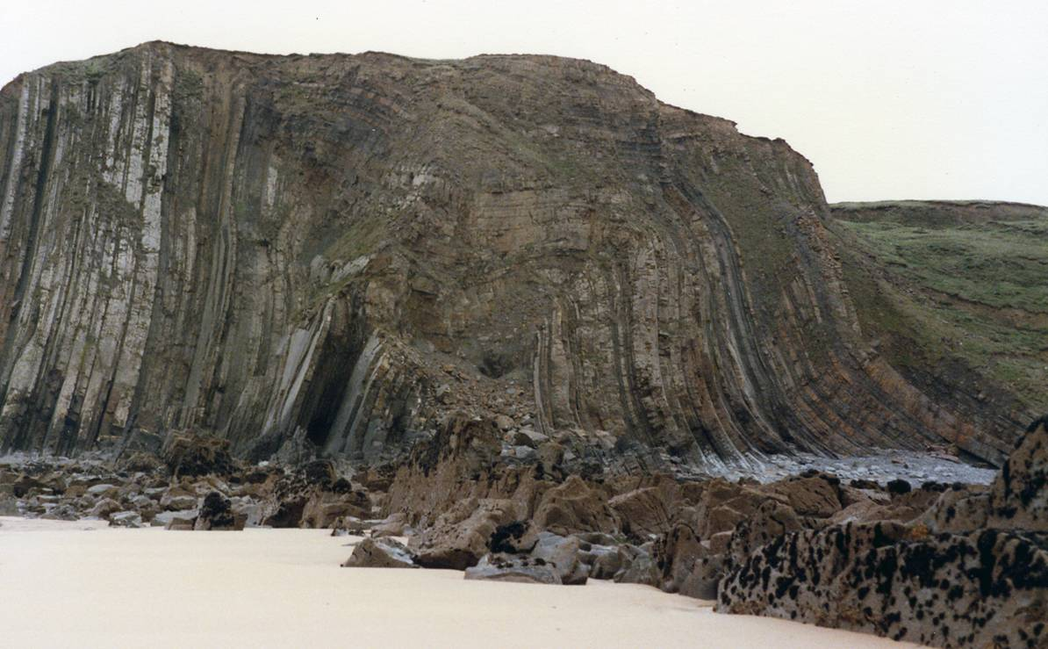
Buckling anisotropic rocks 5
Kink bands are very common late orogenic structures, formed when anisotropic rocks are subjected to final readjustments. Kink bands of this kind (e.g., below left) have earned the nickname “fag-end” structures reflecting the lack of information that they provide about the main deformation events
However, much larger scale folds with kink-band-like geometry (e.g., below right) indicate that this style of folding can have more than “fag-end” significance
Notes:
Photo left (Steve Covey-Crump): dextral contractional kink band, Kinlochleven
Photo right (Steve Covey-Crump): box fold, Northcott Mouth, Bude, North Devon

Slide 19
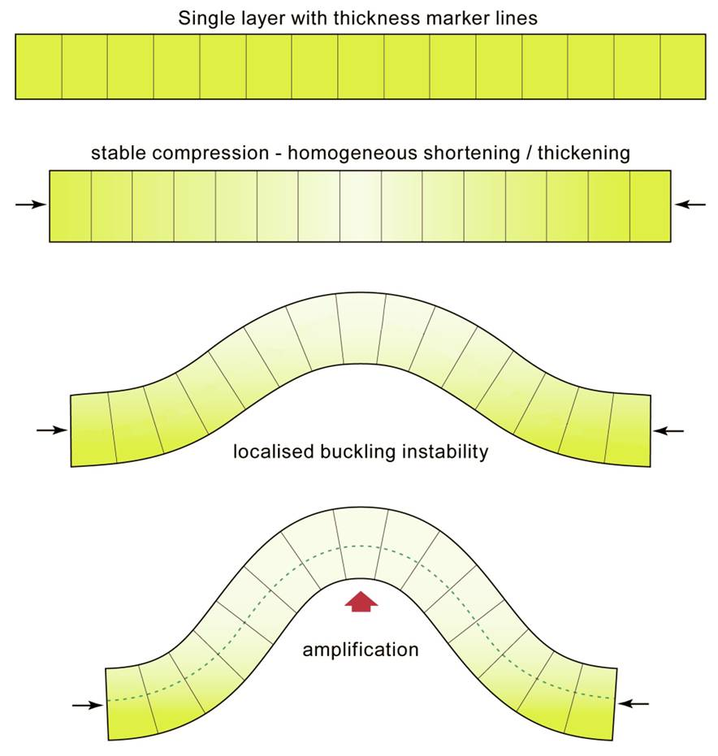
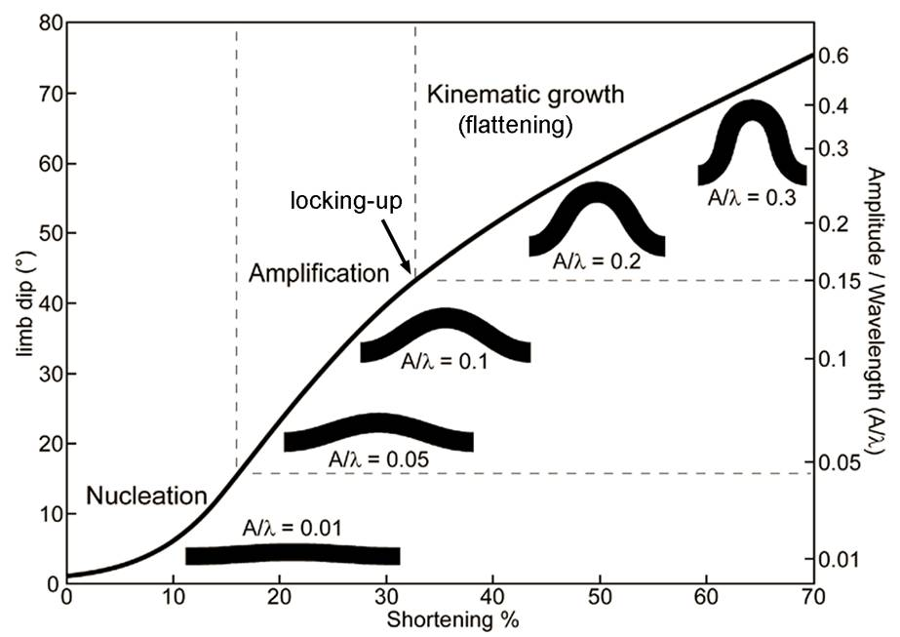
The life and times of a buckle fold 1
The development of buckle folds during layer-parallel compression occurs in 4 stages:
Pre-buckle shortening (layer thickening)
Fold initiation (nucleation)
Fold amplification → locking up
Post-buckle flattening (kinematic growth)
0
1
2
4
3
3
2
Active buckling occurs in stages 2 and 3 but the fold continues to grow passively in stage 4 as the matrix is thickened further
Notes:
It is perhaps more sensible to split the development of buckle folds into three stages rather than four by merging Stages 2 and 3 on the slide, that is, by saying that Stage 2 is just the moment when Stage 3 starts. Then we have:
Pre-buckle, homogeneous layer-parallel shortening
Active buckling (initiation and amplification)
Post-buckle flattening
Figure left from J-P Burg’s 2015 lecture notes (www.files.ethz.ch/structuralgeology/JPB/files/English/7folding.pdf), p.188
Figure right from Schmalholz, 2006, Tectonophysics 419: 41-53, doi:10.1016/j.tecto.2006.03.008, with minor modifications by Steve Covey-Crump

Slide 20
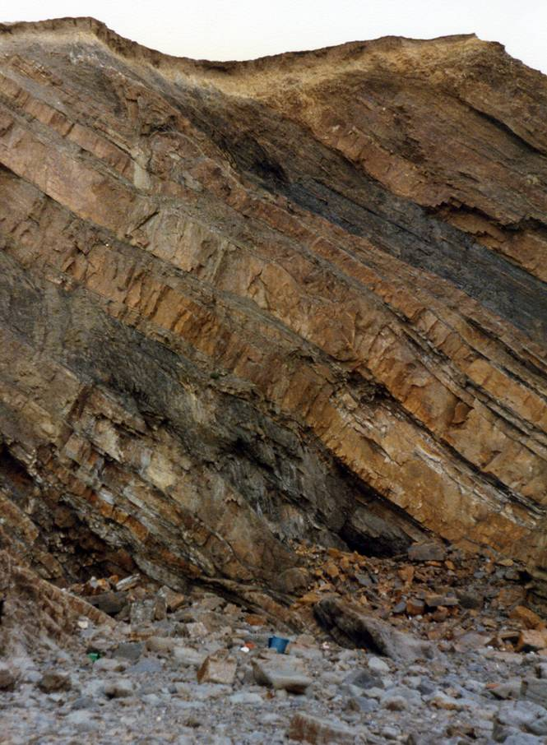
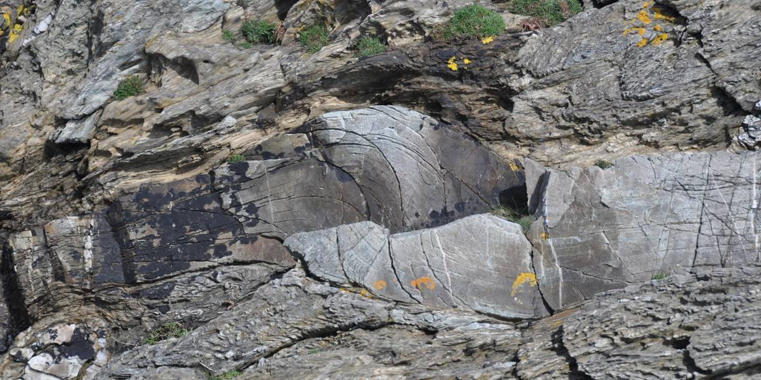
The life and times of a buckle fold 2
Pre-buckle shortening: before folding is initiated, layers undergo shortening and thickening. The amount of shortening depends upon the deformation conditions and the viscosity contrast between the units
Pre-buckle limb thickening by thrusting rather than by homogeneous shortening
Notes:
Photo left (Steve Covey-Crump): Northcott Mouth, Cornwall. Note that the orange-buff weathering sandstone unit contains a thrust just to the right of the centre of the photo
Photo right (Steve Covey-Crump): Rhoscolyn, North Wales. Here there are several over-steepened little thrusts forming a duplex (thrusting/duplexes will be discussed in Class 8)

Slide 21
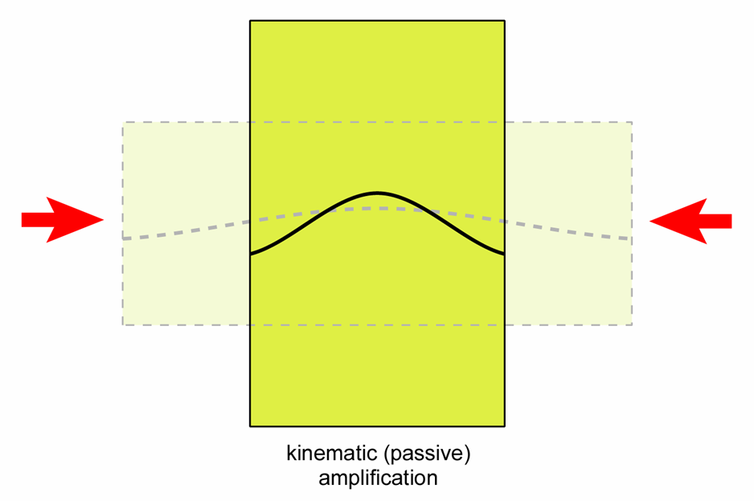
The life and times of a buckle fold 3
Fold initiation: some irregularity in the layer (e.g., some local variation in layer thickness) initiates the onset of folding
  If the competent layers are far enough apart, buckling starts in the different layers independently, until some thick control layer starts to buckle and forces the other layers to readjust their shape (thereby forming accommodation structures)
  Alternatively, if there is no control layer, the multilayer buckles as a whole
Fold amplification and locking up: as the fold grows, the layers rotate with respect to the compression direction, and ultimately
become unfavourably oriented for further buckling → fold locks up
Post-buckle flattening: continued shortening leads to passive growth of the fold – the fold increases in amplitude (and the interlimb angle decreases) as the whole matrix + layer package thickens
Notes:
Locking up occurs prematurely if the deforming rocks become stronger as deformation proceeds. This may arise if rock strength increases with deformation or if something favouring deformation (e.g., pore fluids in the rock) is removed. These points highlight the importance of knowing what processes are actually going on within the rock to accommodate the deformation
Figure by Steve Covey-Crump

Slide 22
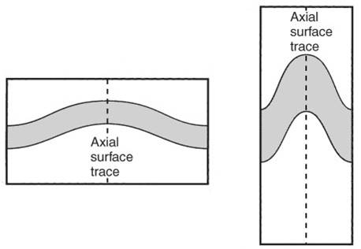
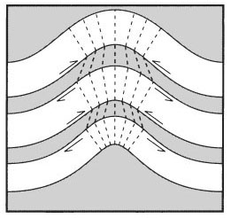
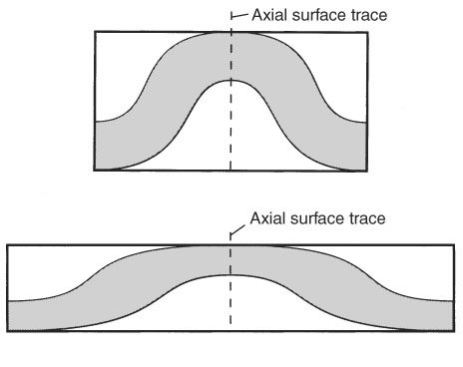
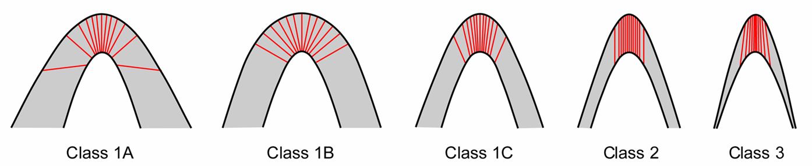
Post-buckle flattening
Post-buckle flattening changes the geometry of a buckle fold from Class 1B to Class 1C; dip isogon analysis allows the amount of flattening to be evaluated
1C
1B
A folded multilayer may have Class 1B competent layers separated by Class 3 less competent interlayers; during continued shortening the Class 3 form of the less competent layers is retained but the competent layers become Class 1C
1B
3
Compression parallel to the axial plane of a Class 1B fold that was formed by buckling changes it into a Class 1A fold
1B
3
1B
1B
1A
Notes:
We noted dip isogon analysis in Class 1 Slides 21-22. For the use of such analyses to extract information about the amount of shortening and mechanical properties of the layer during folding, see Ragan, 2009, Structural Geology: An Introduction to Geometrical Techniques (4th edition), p.388ff (which is based on Lisle RJ, 1997, A fold classification scheme based on a polar plot of inverse layer thickness, in: Sengupta S (editor) Evolution of Geological Structures in Micro- to Macro-scales, p.323-339). Some additional methods of quantifying the amount of post-buckle flattening are described by Srivastava and co-workers (Srivastava, 2003, Tectonophysics 364: 237-241, doi:10.1016/S0040-1951(03)00058-1; Shan & Srivastava, 2006, Geological Magazine 143: 243-247, doi.org/10.1017/S0016756805001688; Srivastava & Shah, 2006, Journal of Structural Geology 28: 1-8, doi:10.1016/j.jsg.2005.09.001; Srivastava & Shah, 2008, Journal of Structural Geology 30: 444-450, doi:10.1016/j.jsg.2008.01.010), but some of the concepts of strain used in these references won’t mean much to you until after Class 3.
Figure top right (from Twiss & Moores, p.374) showing flattening of a buckle fold by continued shortening in the same direction as the compression that led to the initial buckle fold
Figure middle left (from Twiss & Moores, p.378) showing the additional complexities presented by fold geometries in multilayer sequences
Figure middle right (from Twiss & Moores, p.375): showing how Class 1A folds can be produced by flattening, in this case where the flattening is in a different direction to the compression that produced the buckle fold in the first place. This type of flattening may arise towards the end of a contractional deformation episode as units are placed (thrust) on top of the earlier folded units (this type of scenario will be considered in Class 8)
Figure bottom left (redrawn by Steve Covey-Crump from Ramsay, 1967, Folding and Fracturing of Rocks, p.365) shown to remind you of the isogon classification of folds

Slide 23
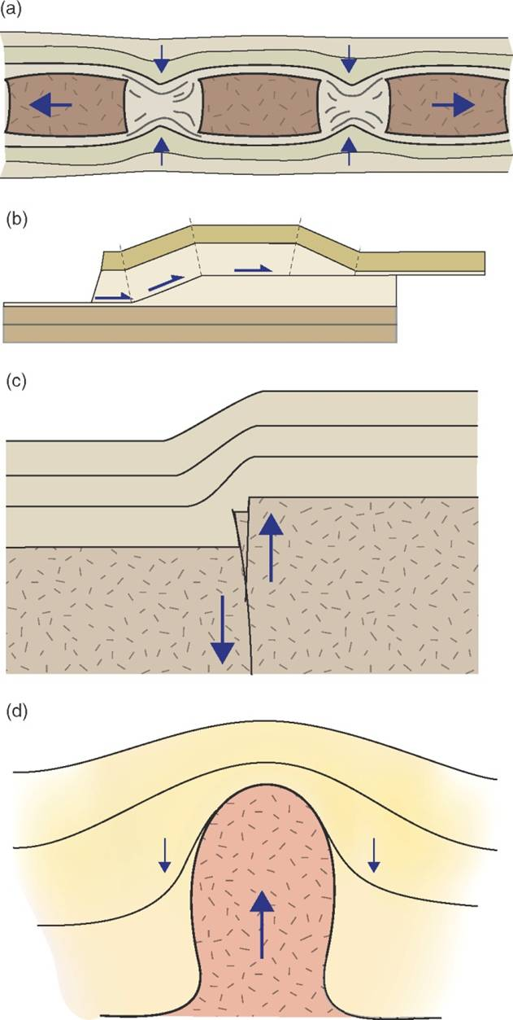
Bending
Bend folds are formed as geometrically necessary folds in response to the deformation of adjacent units
  Neck folds between the boudins in boudinaged layers
  Fault-bend folds where the hanging wall units bend as they move over a fault that changes dip (here illustrated for a thrust ramp situation)
  Drape folds formed in the sedimentary cover in response to faulting in the underlying basement
  Folds formed around intrusions/diapirs that have been intruded forcefully
  Folds formed by differential compaction
The geometry of these folds depends upon the mechanical properties of the folded units and upon the nature of the forcing
Notes:
Note that in all these examples the folding (flexing) of the units arises when non-uniform forces are applied across the layering rather than along it
Figure from Fossen, p.269

Slide 24
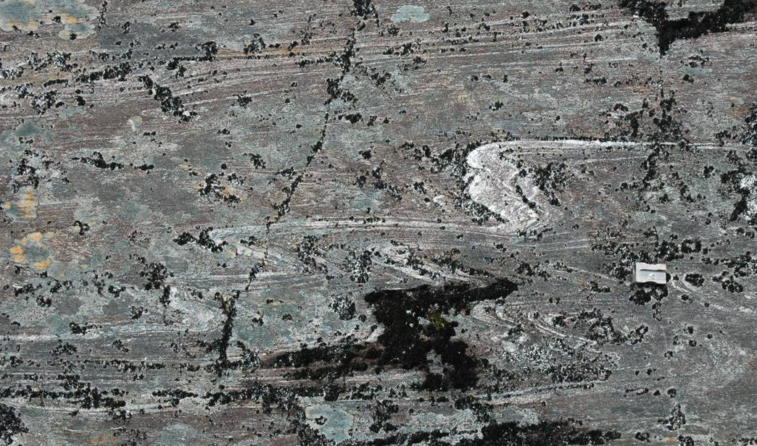
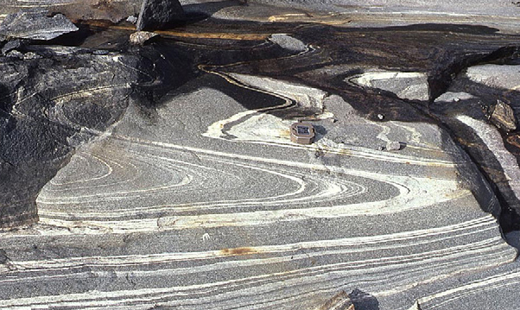
Passive folding
Passive folding is said to occur when the folded layer is a marker band that simply records the deformation of the unit in which it is contained
Good examples occur where layers enter shear zones
If the folded layer was originally parallel-sided, passive folding produces Class 2 similar folds
The growth (amplification) of passive folds is greatest when the difference in mechanical properties between the layer and its host lithology is small → passive folding is more prominent in higher grade rocks
Notes:
Photo top (Steve Covey-Crump): folds within pelites, Kinlochleven. Note the approximately Class 2 geometry of the folded layer with its thickened hinge and highly attenuated limbs
Photo bottom (from Hudleston & Treagus, 2010, Journal of Structural Geology 32: 2042-2071, https://doi.org/10.1016/j.jsg.2010.08.011): passive folds in an amphibolitic gneiss, Swedish Lapland. Note how the folds look like the kind of pattern one sees in the scum on the surface of a pool

Slide 25
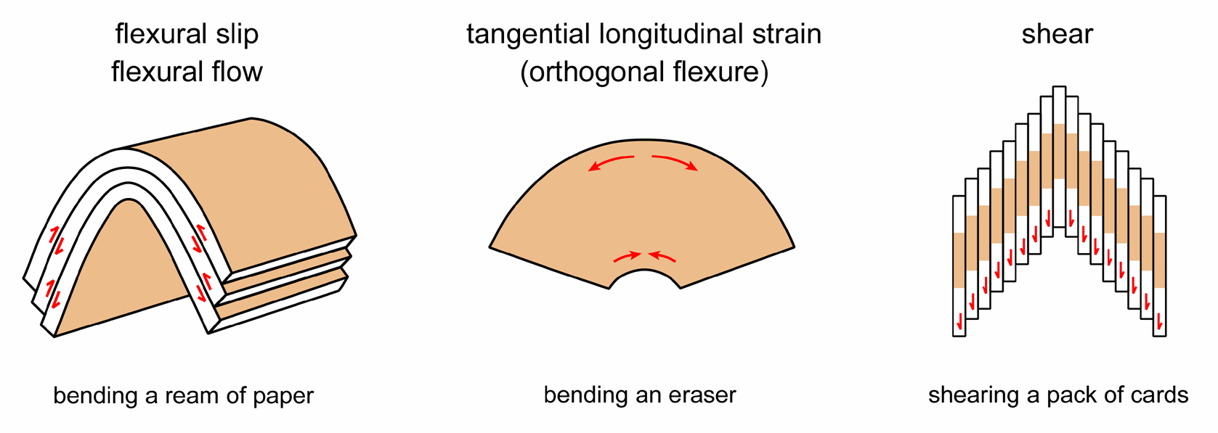
Folding mechanisms
Our discussion of folding types (buckling, bending, passive) has not considered the mechanisms by which folding occurs. Folding mechanisms are of three kinds
Flexural flow/flexural slip and tangential longitudinal strain produce Class 1B folds, and are the folding mechanisms that apply for buckling and bending
Shear folding produces Class 2 folds. In contrast to the other mechanisms, it is not believed to be a real folding mechanism, but it does serve as an extremely useful approximation in the analysis of Class 2 folds
Notes:
Figure by Steve Covey-Crump

Slide 26
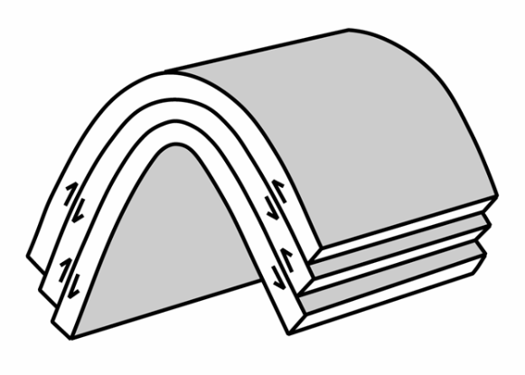

Folding mechanisms (flexural slip/flexural flow)
Flexural slip is like compressing a ream of paper parallel to the sheets – individual sheets slide over each other
  Maximum slip is at the inflection points and decreases towards the hinge where it is zero
  There is no distortion within the plane of the layering
The slip planes are usually bedding or some penetrative fabric such as cleavage
Flexural flow is when the slip planes are close together so that the layer-parallel shear is uniformly distributed across the folded layer; flexural slip is when the slip planes are more widely spaced (e.g., slip occurs on bedding surfaces in an interbedded succession)
Secondary features of flexural slip folds are:
  Lineations on the slip plane (grooves or more commonly crystal fibres) oriented at a high angle to the hinge (slickolites)
  En échelon tension gashes indicating the sense of slip
Notes:
The absence of distortion within the layering means that fossils and other objects lying in the slip plane remain undeformed. This is not true for other folding mechanisms
Slickolites are asymmetric stylolites (see Class 6)
The significance of the tension gashes (and the following points in this bullet) will be appreciated after Class 4. On the figure bottom left, note that on one limb they point one way and on the other limb the other way. This is consistent with the different sense of shear on each limb during flexural slip folding (dextral on the limb left of the antiform hinge, and sinistral on the limb right of the antiform hinge). Note that their sigmoidal form also becomes more pronounced away from the hinge, indicating increasing slip displacement as one moves towards the inflection point
Figure top right by Steve Covey-Crump
Figure bottom left from Price & Cosgrove, p.250

Slide 27

Folding mechanisms (flexural slip/flexural flow)
One of the characteristic features of flexural flow folding derives from the fact that there is no distortion within the slip planes (e.g., bedding planes):
a pre-existing lineation on the bedding plane making an angle α to the future fold axis, remains at angle α to the fold axis after folding
Hence on a stereogram, folding spreads the lineation along a small circle about the fold axis
Notes:
Figure redrawn by Steve Covey-Crump from Ramsay, 1967, Folding and Fracturing of Rocks, p.463 and p.466. The diagram on the bottom right side of the figure shows what happens if there is some post-buckle flattening

Slide 28



Folding mechanisms (tangential longitudinal strain)
Tangential Longitudinal Strain (TLS) folding is like compressing an eraser parallel to its length: the outer arc of the layer experiences extension and the inner arc experiences compression; between them is the neutral surface where the deformation cancels out
The maximum deformation is at the hinge and decreases towards the inflection points where it is zero
Secondary features of TLS folds include extension fractures in the outer arc, and intensified cleavage or conjugate thrusts in the inner arc
Notes:
Figure top right redrawn by Steve Covey-Crump from Ramsay, 1967, Folding and Fracturing of Rocks, p.398. The black shapes are strain ellipses (discussed in Class 3) – they show the shape that an initially circular object deforms into
Figure bottom right from Price & Cosgrove, p.251
Photo (Steve Covey-Crump): extension fractures (infilled with vein material) in the outer arc of an antiform hinge, Aberystwyth Grits, Aberystwyth

Slide 29

Folding mechanisms (tangential longitudinal strain)
The influence of tangential longitudinal strain folding on pre-existing lineations is more complex than in the flexural flow case; on a stereogram the lineations are spread within a sector, their position within that sector depending upon where within the folded layer they occur
Notes:
Figure redrawn by Steve Covey-Crump from Ramsay, 1967, Folding and Fracturing of Rocks, p.464

Slide 30

Folding mechanisms (shear folding)
Shear folding is like shearing a deck of cards: the shear planes are parallel to the axial surface of the fold
The influence of shear folding on a pre-existing lineation is to reorient it within a plane, and so on a stereogram the lineation is spread along a great circle. The intersection of this great circle with the shear plane (axial plane) is the tectonic a-direction. If the folding is caused by shearing on a fault, this is the orientation of the fault slip vector
Notes:
Shear folding is frequently the best approximation for folds found in fault zones (shear zones). The axial plane of such folds is parallel to the fault plane (shear zone boundary). Hence measuring the plunge/plunge direction of a lineation as it is deformed into a fault zone and then finding where the great circle containing these lineations intersects the great circle for the fault plane, allows one to determine the orientation of the fault slip vector. This is a very helpful technique and will be a major focus of the exercises in more than one of our practical classes. Anyone undertaking geological mapping in an area containing significant faults, ought to become very familiar with this technique
Figure redrawn by Steve Covey-Crump from Ramsay, 1967, Folding and Fracturing of Rocks, p.470

Slide 31
Non-cylindrical folds
Notes:
Most of the discussion over Classes 1 and 2 has been framed in terms of cylindrical folds, that is, folds that have the same shape on all cross-sections that are drawn in the same orientation but at different locations along the fold axis. However, real folds are generally non-cylindrical. All the terminology so far discussed still applies but it is worth considering some special instances of non-cylindrical folds

Slide 32




Periclines and fold hinges that bifurcate
Folds do not go on until they wrap right around the Earth: they grow and die out along the fold axis, or the fold hinge may bifurcate
This may happen on all scales up to that of the orogenic belt. A common spatial arrangement is that of elongate domes (periclines) arranged in an en échelon array
Zagros mountains periclines, Iran
Pericline
Bifurcating hinges
En échelon periclines closer than ~half a wavelength may link or, if separated by more than this, may overlap and lock each other up
Notes:
The development of spatial arrangements of folds can be explored using the buckling models and experiments noted on previous slides. The existence of systematic spatial arrays of folds highlights the fact that it is important not only to describe the profile plane geometry of folds but also their map distribution
Image top right (Fossen, one of the extra figures on the web-site for the book, folk.uib.no/nglhe/StructuralGeoBook.html): periclines above salt domes, satellite image deriving ultimately from NASA
Figure middle top from Price & Cosgrove, p.263
Figure middle bottom from Price & Cosgrove, p.265
Photo bottom left (Steve Covey-Crump): kink bands, south side of Boscastle Harbour, north Cornwall

Slide 33



Sheath folds
Folds with hinge lines that curve through more than 90° within the axial surface are described as sheath folds
They are commonly associated with a strong stretching lineation
Sheath folds form by passive amplification of some initial irregularity within a layer that is subject to layer-parallel shear
They are a feature of shear zones and so we will return to them in Class 4
Notes:
In the extreme case sheath folds take on a tubular shape. Hence the old French name for them – condom folds
Sheath folds have curved hinge lines with an axial surface that is approximately planar. Folds can arise that have straight hinge lines and curved axial planes – these are called polyclinal folds (see notes to Slide 39). Of course, we may also have folds with curved hinge-lines and curved axial planes, and this is commonly the case for soft-sediment folds (see next slide)
Figure top right from Price & Cosgrove, p.268
Photo bottom left (from www.uni-muenster.de/GeoPalaeontologie/Geologie/Endogen/Gallery.html): sheath-folded quartz veins, Cadaques, eastern Spain
Photo bottom right (from Alsop & Carreras, 2007, Journal of Structural Geology 29: 1915-1930, https://doi.org/10.1016/j.jsg.2007.09.010): sheath folds from the El Llimac shear zone, Cap de Creus, NE Spain. The Alsop & Carreras paper from which this photo comes provides a good case example of how to describe sheath folds, and how to use their geometry to extract information about how they developed

Slide 34


Soft sedimentary folds
Soft sediment deformation generally produces highly non-cylindrical folds because unlithified and water-saturated sediment is weak enough for it to respond to small changes in the direction of the forces driving the deformation (e.g., as it encounters obstacles to its motion)
Convolute slump folds (above); ice drag folds in glacial deposits (below)
Notes:
The complexity of the fold geometries arising during soft sediment deformation is generally too great for it to be meaningful to attempt a full geometric description. However, for a study of the features of folds (and associated congruent minor structures) that are produced by soft sediment deformation, and which help to distinguish them from folds formed by tectonic deformation, see Alsop et al., 2019, Journal of Structural Geology 125: 248-255, https://doi.org/10.1016/j.jsg.2017.09.001
Photo top (Steve Covey-Crump): convolute folds interpreted as forming by soft sediment deformation in the core of the Rhoscolyn antiform, Anglesey, North Wales
Photo bottom (BGS image database: geoscenic.bgs.ac.uk/asset-bank/action/viewHome, image P205520): folded glacial deposits, Beeston Regis, near Cromer, Norfolk

Slide 35



Refolded folds
Folds generated by two (or more) phases of deformation are non-cylindrical except for the special case where the folding events are coaxial and coplanar
Refolded folds
Notes:
The geometry of refolded folds may be unravelled using the congruent minor structures associated with each folding event because although a second folding event may change the geometry of first folds, it cannot change the asymmetry of its associated minor structures
Photo top right (Steve Covey-Crump): a small refolded fold from the New Harbour Group, Trearddur Bay, Holy Island, North Wales
Photo left (Steve Covey-Crump): refolded folds, Moine metasediments, glaciated pavement above the A830, 4¼ km west of Glenfinnan, Scotland. This locality, which shows some spectacular refolded folding, is described in Strachan et al., 2010, An Excursion Guide to the Moine Geology of the North-West Highlands of Scotland, p.65-68
Photo bottom right (Steve Covey-Crump): refolded folds, Moine metasediments, Ross of Mull, Scotland

Slide 36



Refolded folds (fold interference patterns)
The outcrop patterns of refolded folds have been classified into four basic fold interference patterns according to the orientation of the fold axes and the axial planes of the two phases of folding relative to each other
Type 0 is the coaxial and coplanar case – the 2nd phase of folding merely intensifies the 1st fold structure
Visualization requires considerable mental dexterity
Notes:
Nomenclature: F₁, F₂ refer to folds from the first deformation event and second deformation event respectively; S₁ and S₂ refer to the axial planes of the F₁ and F₂ folds respectively (see Class 1 Slide 35)
Not everyone finds it easy to visualize fold interference patterns. To assist the process, the Fault Analysis Group at University College Dublin have generated some paper models to illustrate the geometry (see www.fault-analysis-group.ucd.ie, use the “Educational Material” tab and go to “Superposed Folds”). The image bottom left on this slide comes from that web page
Figures top right and bottom right are redrawn by Steve Covey-Crump from Ramsay, 1967, Folding and Fracturing of Rocks, p.521 and p.531

Slide 37


Refolded folds (Type 1: dome and basin)
In Type 1 refolded folds, the fold axes are at 90° to each other, both folds are upright with axial planes that are at 90° to each other. The result is a series of domes and basins
Notes:
Figures redrawn by Steve Covey-Crump from Ramsay, 1967, Folding and Fracturing of Rocks, p.522 and p.531. The top right figure is annotated by Steve Covey-Crump

Slide 38


Refolded folds (Type 2: dome-crescent-mushroom)
In Type 2 refolded folds, the fold axes are at 90° to each other, but one set of folds is recumbent and the other is upright. The result is a characteristic crescent or mushroom-shaped outcrop pattern
Notes:
Figures redrawn by Steve Covey-Crump from Ramsay, 1967, Folding and Fracturing of Rocks, p.527 and p.531. The top right figure is annotated by Steve Covey-Crump

Slide 39


Refolded folds (Type 3: convergent-divergent)
In Type 3 refolded folds, the fold axes are approximately coaxial, but one set of folds is recumbent and the other is upright. The result is a wavy form of outcrop pattern
Notes:
In Type 3 refolded folds the F₁ and F₂ fold axes are in approximately the same direction (that’s what coaxial means). However, the axial surfaces for the two sets of folds (S₁ and S₂) are very different. Hence the end result is approximately straight F₁ and curved S₁. This is a polyclinal fold (see notes to Slide 33). Polyclinal folds may actually be developed in one single deformation event, that is, the fact that we have a Type 3 fold interference pattern does not automatically mean that we have two folding events. It is not easy to get one’s head around how Type 3 fold interference patterns can be generated in a single folding event but an attempt to show that this is so is described by Carreras & Druguet, 2019, Journal of Structural Geology 125, 195-201, https://doi.org/10.1016/j.jsg.2018.07.015
Figures redrawn by Steve Covey-Crump from Ramsay, 1967, Folding and Fracturing of Rocks, p.533 and p.531. The top right figure is annotated by Steve Covey-Crump

Slide 40



Refolded folds – examples of the three types
Type 1
Type 3
Type 2
Notes:
Photo top left (from Ramsay, 1967, Folding and Fracturing of Rocks, p.524): folded Moine metasediments, east end of Loch Monar, Scotland. The locality where this photo comes from is described in Strachan et al., 2010, An Excursion Guide to the Moine Geology of the Northern Highlands of Scotland, (p.153-161, particularly locality 8.3)
Photo bottom left (from Ramsay, 1967, Folding and Fracturing of Rocks, p.529): folded Moine metasediments, Loch Hourne, Scotland
Photo right (from https://www.reddit.com/r/geology/comments/6g6jdg/refolded_folds_in_the_dalradian_metasediments_of/): refolded thin-bedded quartzite within a dominantly pelitic unit (Binnein Schists), Kinlochleven, Scotland. Note how the early fold hinges and the later fold hinges are approximately coaxial

Slide 41

Refolded folds – the real world
Fold interference patterns when the folds from one or both phases are non-cylindrical may be complex
Notes:
The interference patterns on the previous few slides are defined for situations in which the folds from each deformation phase are cylindrical. In reality, the folds from one or both phases may be non-cylindrical and so rather more complex fold interference patterns may arise
For experiments designed to examine the factors that influence refold geometry, see Ghosh et al., 1992, Journal of Structural Geology 14: 381-394, https://doi.org/10.1016/0191-8141(92)90100-B; Grujić, 1993, Journal of Structural Geology 15: 293-307, https://doi.org/10.1016/0191-8141(93)90127-V
Your September field course mapping area (Aliaga, northern Spain) provides a splendid example of large-scale refolded folds – for a description of these see Simón, 2004, Journal of Structural Geology 26: 1447-1464, https://doi.org/10.1016/j.jsg.2003.11.026
Photo (Steve Covey-Crump): refolded Binnein Schists, loch-side, Kinlochleven

Slide 42

Reading
Fossen H (2016) Structural Geology (2nd edition). Cambridge University Press. [Chapter 12]
Twiss RJ, Moores EM (2007) Structural Geology (2nd edition). WH Freeman and Co. [Chapter 13]
Price NJ, Cosgrove JW (1990) Analysis of Geological Structures. Cambridge University Press. [Chapters 10, 11, 12, 13, 14, 15]
Ramsay JG, Huber MI (1987) Techniques of Modern Structural Geology. Volume 2: Folds and Fractures. Academic Press. [Sessions 19, 20, 21, 22]
In the notes frequent mention has been made of
Ramsay JG (1967) Folding and Fracturing of Rocks. McGraw-Hill
This is a classic text. It is particularly strong on the analysis of the effect of folding on pre-existing lineations and planar features, and on refolding in general (John Ramsay essentially developed the systematic framework within which refolded folds are now considered). This material is all contained in the Ramsay & Huber text noted above, but the original Ramsay text covers it more succinctly
John Ramsay
Notes:
John Ramsay died not long ago. For an on-line obituary, see https://erdw.ethz.ch/en/news-events/news/archive/2021/01/in-memoriam-john-ramsay.html

